Slide 1
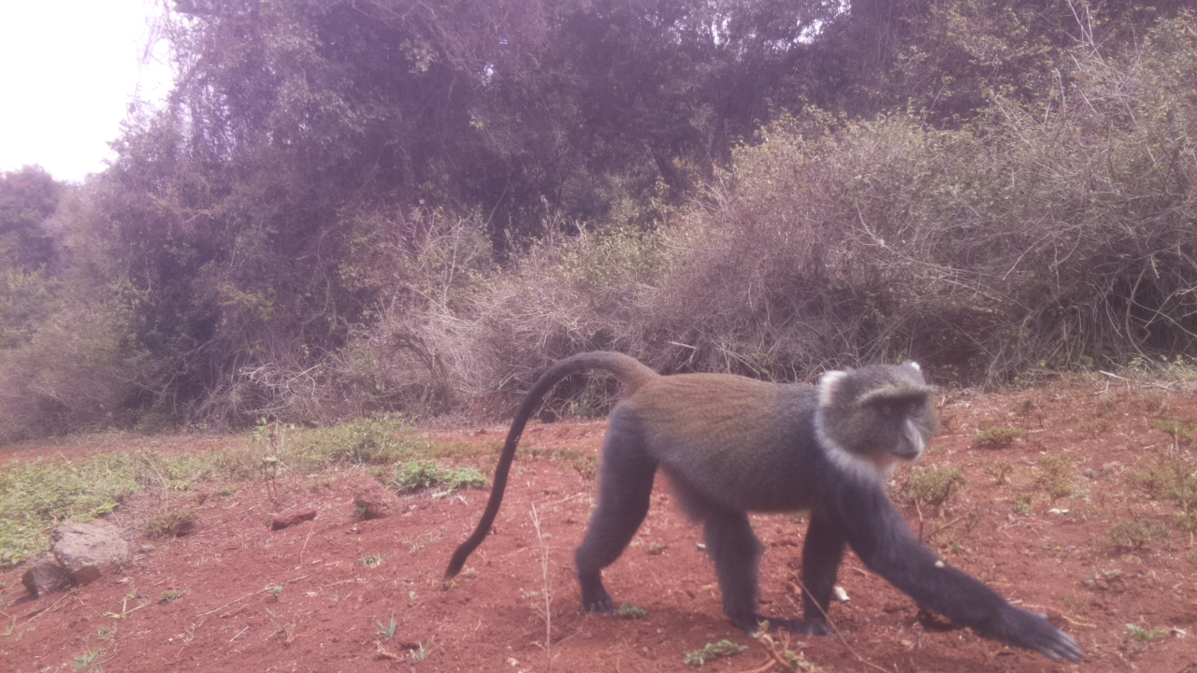
DSAIL-Porini: Annotated camera trap images of wildlife species from a conservancy in Kenya
Lorna Mugambi
Centre for Data Science and Artificial Intelligence (DSAIL)

Slide 2
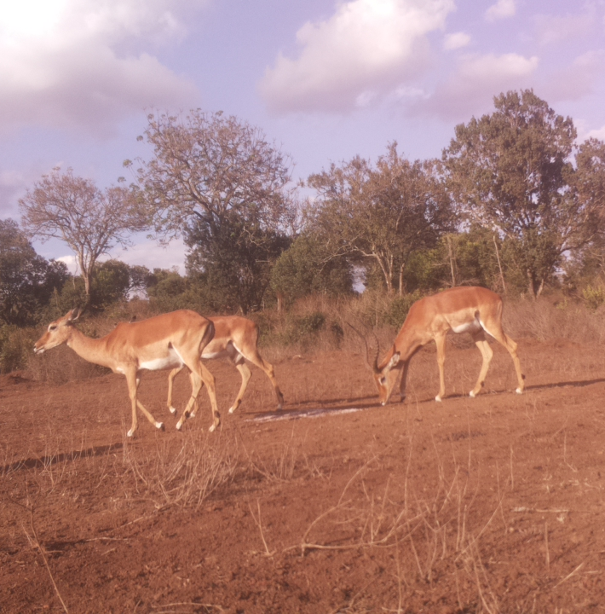
Introduction
The advantage of camera traps is they can record accurate data without disturbing animals especially since they have no moving parts.
These data can be reviewed/used by other researchers.
Camera traps have replaced the use of traditional monitoring techniques such as capture and release which were invasive to the animals.
We currently have 4 camera traps deployed in the conservancy deployed for 7 months; from June 2021 to December 2021

Slide 3
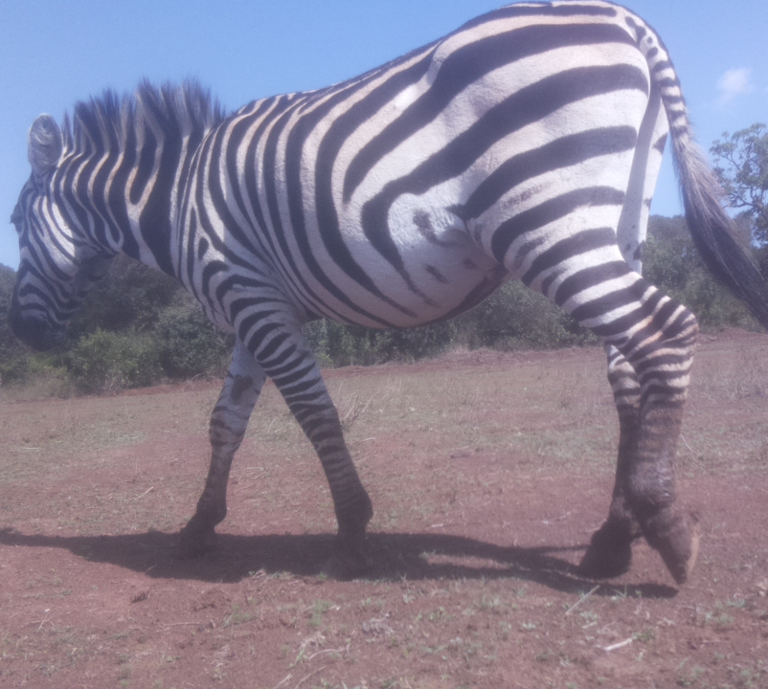
DSAIL-Porini Dataset
From the camera traps deployed we have a total of 8524 annotated images of animals;
The dataset has 6 categories; impalas, warthogs, zebras, monkeys, waterbucks and bushbucks.

Slide 4
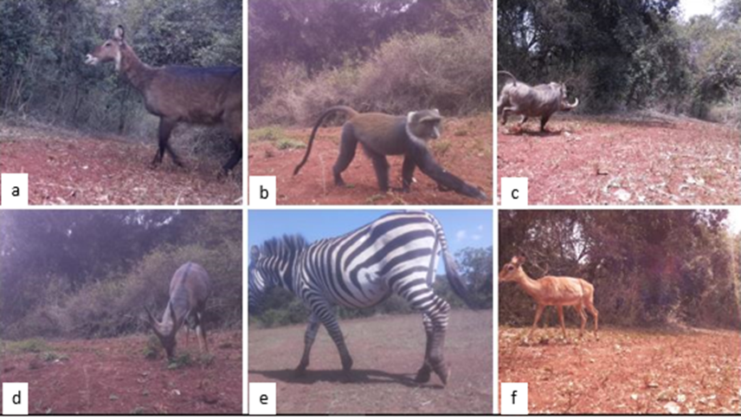
Species in the conservancy

Slide 5
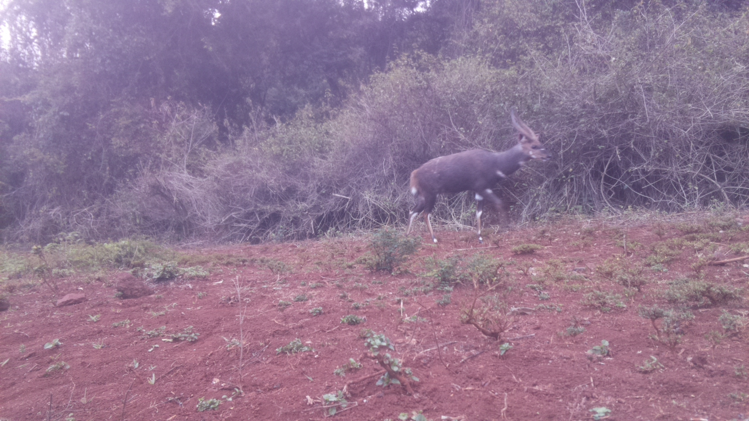
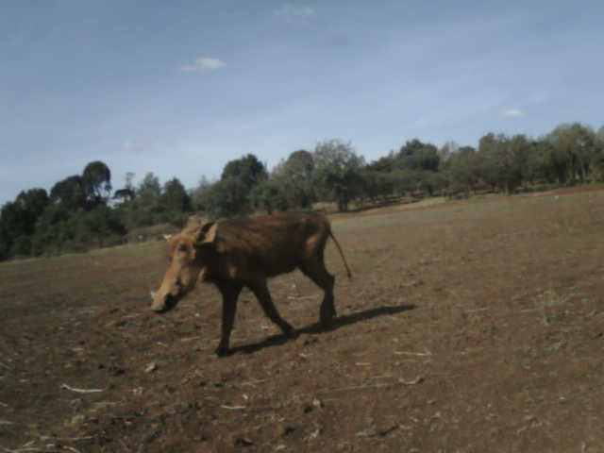
Value of the Data
A well annotated dataset can be used to train machine learning models to detect, classify and segment images of animals.
These data can be used to test image based censusing algorithms as it includes animal counts.
These data will be useful in testing multiple label machine learning algorithms
These data can be used to understand animal behaviour, estimate the size of the animal population with time, learn about how animals interact, where they are most likely to be found and how they feed.

Slide 6
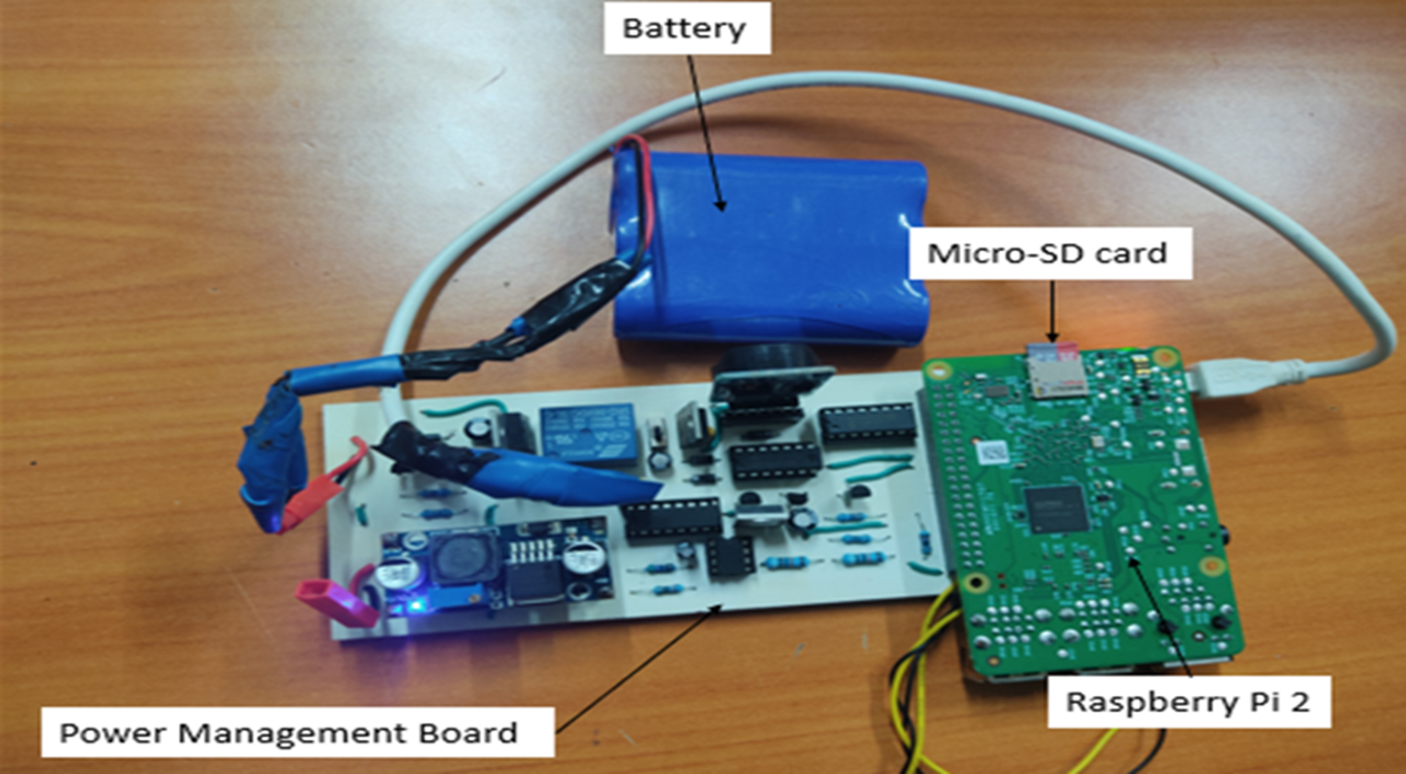
Hardware
Two of our camera traps are based on the raspberry pi 2, one on a raspberry pi zero and the other on open mv
They all use python code, which works in a way that once a PIR sensor is triggered by motion, an image is captured by the camera and saved in an SD card (YYYY-MM-DD-H-M-S format)
The camera traps based on the raspberry pi's currently run on two windows. From 6 am to 11 am and from 2pm to 6pm
The open mv based camera trap runs on one window.

Slide 7
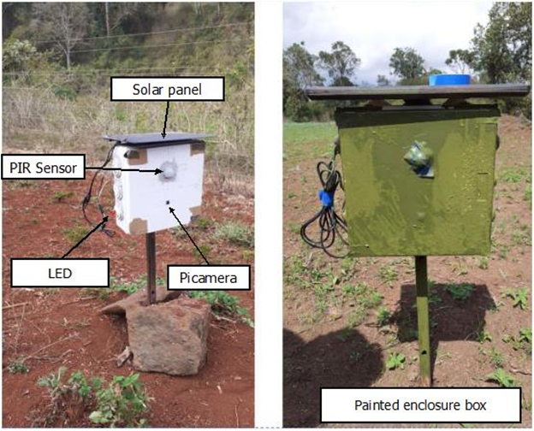
Deployment
We painted the camera traps green so that they could be camouflaged.
We noticed a change afterwards. We got more close ups of animals like the waterbuck.

Slide 8
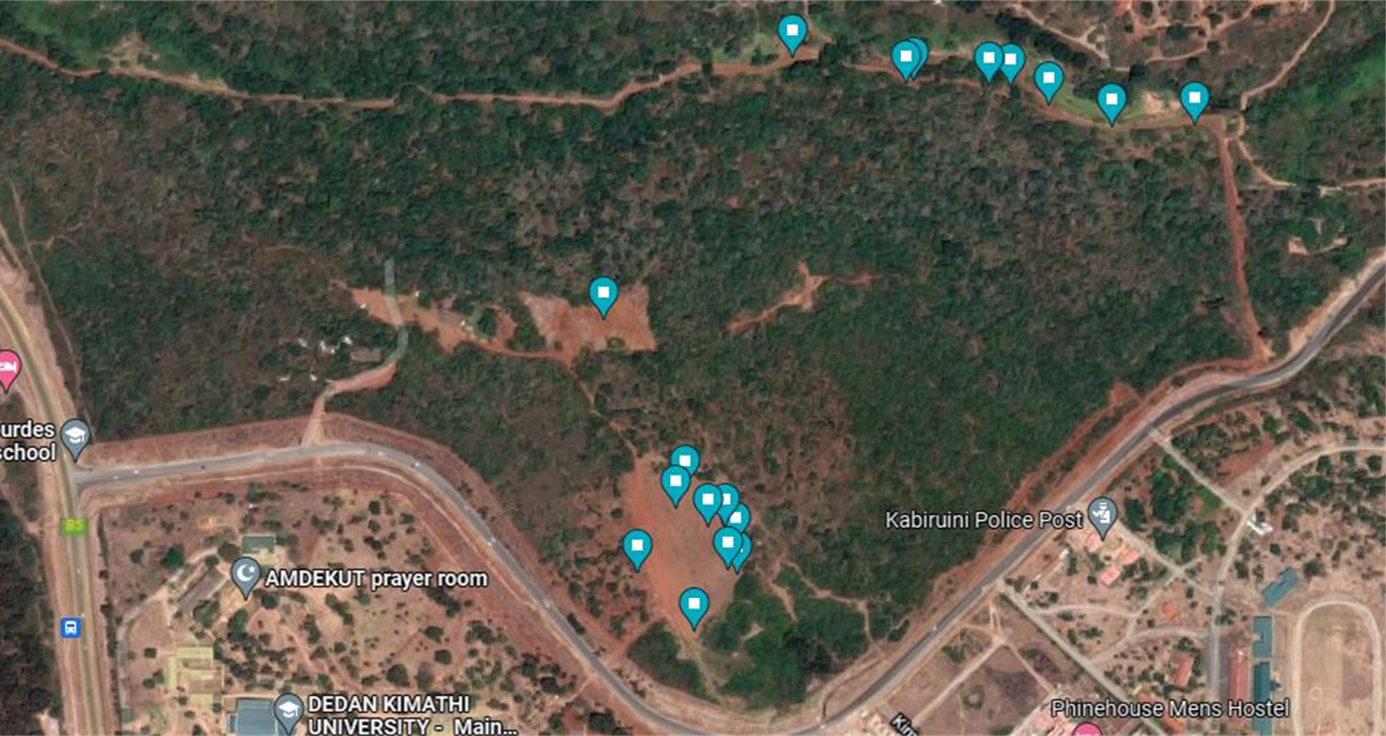
Camera trap placement

Slide 9
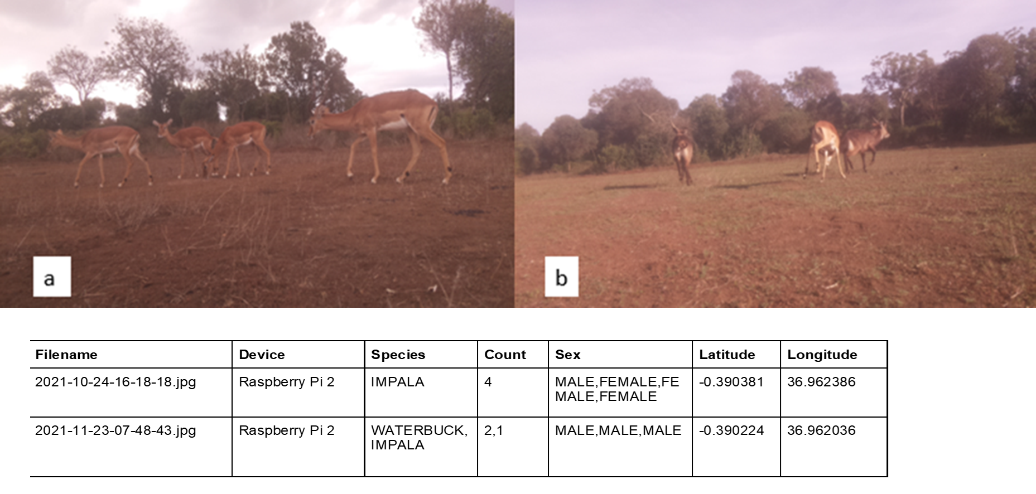
Data Annotation

Slide 10
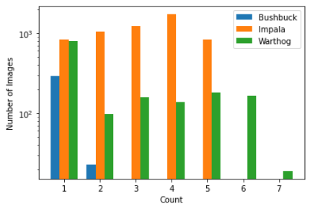
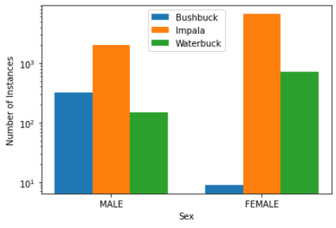
Data analysis
Count distribution
Sex distribution

Slide 11
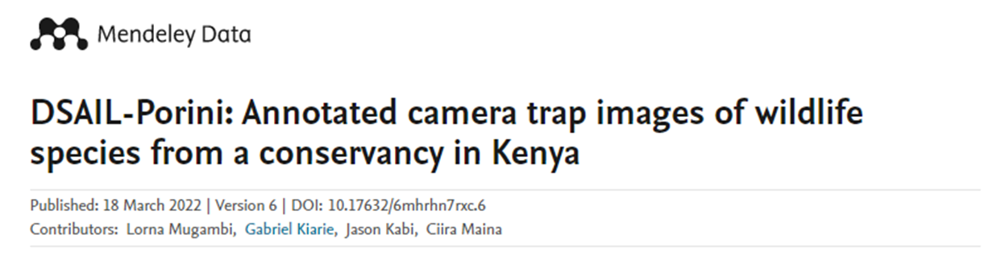
Publications
L. Mugambi, J. Kabi, G. Kiarie and C. wa Maina, “DSAIL-Porini: Annotated camera trap images of wildlife species from a conservancy in Kenya," Submitted, 2022.

Slide 12
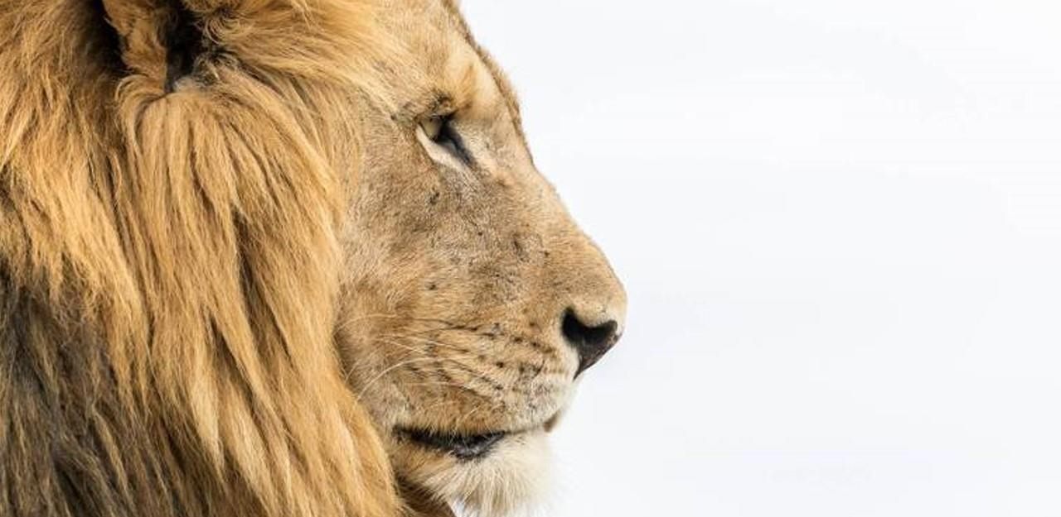

The way to get started is to quit talking and begin doing.
Walt Disney
Lorna Mugambi lorna.mugambi@dkut.ac.ke

